Slide 1

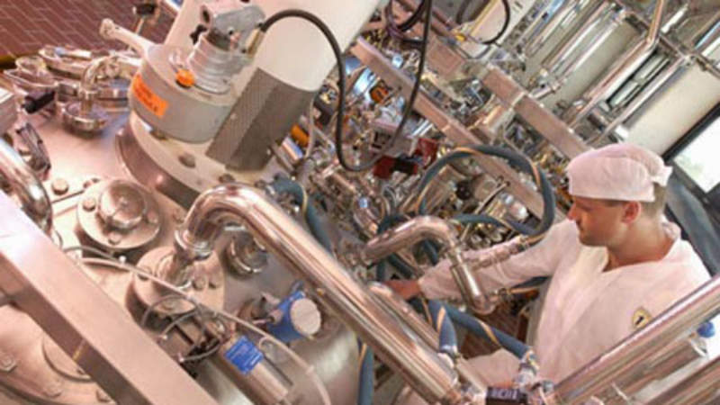


Vitamins
Presentation by
Primary Information Services
www.primaryinfo.com
mailto:primaryinfo@gmail.com

Slide 2
Vitamins
Vitamins are substances that your body needs to grow and develop normally. There are 13 vitamins your body needs. What are the 13 essential vitamins?
The 13 essential vitamins your body needs are vitamins A, C, D, E, K and the B vitamins: thiamine (B1), riboflavin (B2), niacin (B3), pantothenic acid (B5), pyroxidine (B6), biotin (B7), folate (B9) and cobalamin (B12). The four fat-soluble vitamins—A, D, E, and K—are stored in the body's fatty tissues.
Primary Information Services
www.primaryinfo.com

Slide 3
Vitamins
Fat-soluble vitamins
Fat-soluble vitamins are stored in the fatty tissues of the body and the liver. Vitamins A, D, E, and K are fat-soluble. These are easier to store than water-soluble vitamins, and they can stay in the body as reserves for days, and sometimes months.
Fat-soluble vitamins are absorbed through the intestinal tract with the help of fats, or lipids.
Presentation by
Primary Information Services
www.primaryinfo.com
mailto:primaryinfo@gmail.com

Slide 4
Vitamins
Water-soluble vitamins
Water-soluble vitamins do not stay in the body for long. The body cannot store them, and they are soon excreted in urine. Because of this, water-soluble vitamins need to be replaced more often than fat-soluble ones.
Vitamin C and all the B vitamins are water soluble.
Presentation by
Primary Information Services
www.primaryinfo.com
mailto:primaryinfo@gmail.com

Slide 5
Vitamins
Catalytic processes in vitamins synthesis and production methods represent ideal tools to lower production costs, and consequently gain an economical advantage, by the application of environmentally benign processes.
Examples of industrially important transformations are grouped by reaction types, e.g. hydrogenation, oxidation and various alkylation, rearrangement, cycloaddition, and esterification reactions.
Presentation by
Primary Information Services
www.primaryinfo.com
mailto:primaryinfo@gmail.com

Slide 6
Vitamins
Presentation by
Primary Information Services
www.primaryinfo.com
mailto:primaryinfo@gmail.com
What do vitamins do for the body?
Vitamins and minerals are considered essential nutrients—because acting in concert, they perform hundreds of roles in the body. They help shore up bones, heal wounds, and bolster your immune system. They also convert food into energy, and repair cellular damage

Slide 7
Vitamins
Presentation by
Primary Information Services
www.primaryinfo.com
mailto:primaryinfo@gmail.com
What are vitamins made of?
Unlike dietary minerals, which are elements on the periodic table, vitamins are molecules made from the elements. Vitamin C (ascorbic acid), for example, is made of carbon, oxygen and hydrogen and is found naturally in nature and can be produced by many animals – but not humans, fruit bats or guinea pigs.

Slide 8
Vitamins
Presentation by
Primary Information Services
www.primaryinfo.com
mailto:primaryinfo@gmail.com
What are the risks of taking multivitamins?
But routinely getting an overload of vitamins and minerals can hurt you. Too much vitamin C or zinc could cause nausea, diarrhea, and stomach cramps. Too much selenium could lead to hair loss, gastrointestinal upset, fatigue, and mild nerve damage.

Slide 9
Vitamins
The vitamins market was valued at USD 4.85 billion in 2017; it is projected to reach USD 7.35 billion by 2023, at a CAGR of 7.3% during the forecast period. The growth in the demand for functional and nutritionally enriched processed food products, the prevalence of vitamin deficiencies, and feed fortification due to rise in global meat & dairy product consumption are factors driving this market.
Presentation by
Primary Information Services
www.primaryinfo.com
mailto:primaryinfo@gmail.com

Slide 10
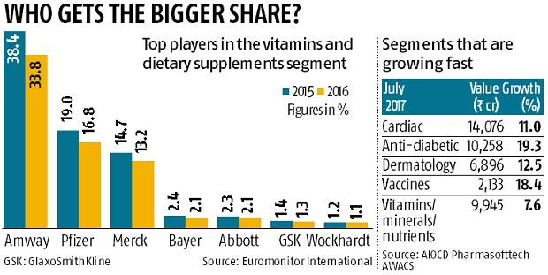
Vitamins
Presentation by
Primary Information Services
www.primaryinfo.com
mailto:primaryinfo@gmail.com

Slide 11
Vitamins
Vitamin was majorly used ingredient for the formation of dietary supplements, accounting for 33% of total market share in 2018 because of its ability to be easily excreted by kidneys. The product is expected to find more application among working professionals and sports athletes in the form of multivitamin tablets, powders, and liquids over the next seven years.
Presentation by
Primary Information Services
www.primaryinfo.com
mailto:primaryinfo@gmail.com

Slide 12

Vitamins
Contact
Primary Information Services
www.primaryinfo.com
mailto:primaryinfo@gmail.com
QUESTIONS?

